Slide 1
MSc Project
(CMP060L050H)
Mid Point Presentation
Credit Card Fraud Detection Using Machine Learning
Student Name:
Date:
Supervisor:
Second Marker:

Slide 2
Outline
Context​
Problematic statement​
Objectives ​
Methodology​
Software and Hardware Requirements
Selection of machine learning algorithms
Progress and Next Steps
Literature review​
Contributions
Conclusion

Slide 3
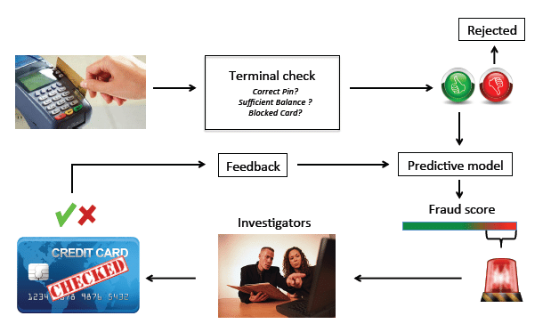
Context
Rapid growth of online and contactless card payments.
Large transaction volumes require automated monitoring.
Fraud behaviour changes across time and digital channels [1].
Machine learning can learn patterns from historical transactions [1].
Figure 1 : credit card fraud detection process
(Source: [1])
Notes:
Digital banking, e-commerce and contactless payments have increased the number and speed of financial transactions. This growth has also increased opportunities for credit card fraud. Manual monitoring is not suitable for very large transaction datasets, while fixed rules may become less effective when fraud behaviour changes. Machine learning offers a data-driven method for identifying unusual and hidden transaction patterns. The current project therefore investigates how supervised machine-learning algorithms can support reliable fraud detection using an anonymised credit card transaction dataset.

Slide 4
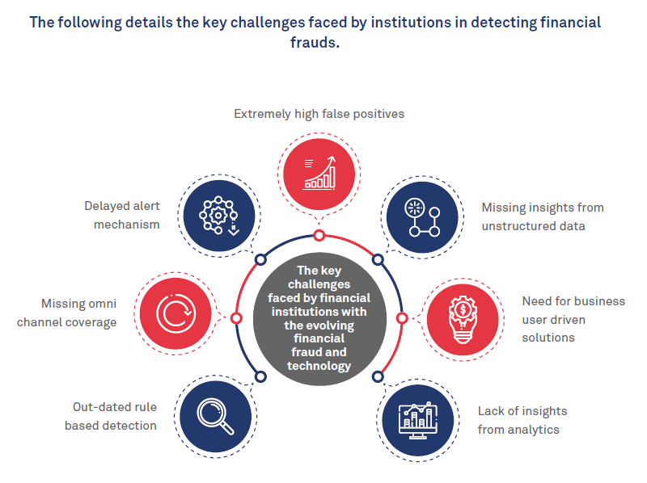
Problem Statement - WHY
Problem: Lack of reliable detection for rare and changing fraud patterns [2].
Affected: banks, payment providers, merchants and cardholders.
Where/when: online, contactless and other real-time card transactions.
Manual investigation is time-consuming and creates high cost.
However, high accuracy can still hide missed fraudulent transactions [2].
Importance: earlier detection can reduce loss, disruption and customer harm.
Figure 2: key fraud-detection challenges
(Source: [2])
Notes:
The project tackles the challenge of detecting rarely occurring and evolving credit card fraud patterns. The issue arises when banks and payment service providers perform real-time processing of high volume types of card transactions, like online or contactless payments. It impacts financial institutions, merchants, and cardholders, as it can lead to financial losses if fraud goes undetected and disrupt legitimate transactions if it is a false alarm. Also, the Manual investigation is very slow and costly. But with severe class imbalance, it can have a low model which correctly predicts high accuracy and fail to predict fraud. This problem is significant to reduce the loss, investigation cost, and customer's inconvenience.

Slide 5
Objective - WHAT
To understand and clean the credit card transaction dataset.
To explore fraud patterns through data visualization.
To select relevant predictive variables.
To prepare an imbalanced dataset for modeling.
To train five supervised machine-learning algorithms.
To compare performance using multiple evaluation measures.
To identify the most suitable model for this dataset.
Notes:
The project aims to develop and compare supervised machine-learning models for credit card fraud detection. These objectives provide a clear route from raw transaction data to an evidence-based recommendation, without claiming model performance before the experimental stage has been completed.

Slide 6
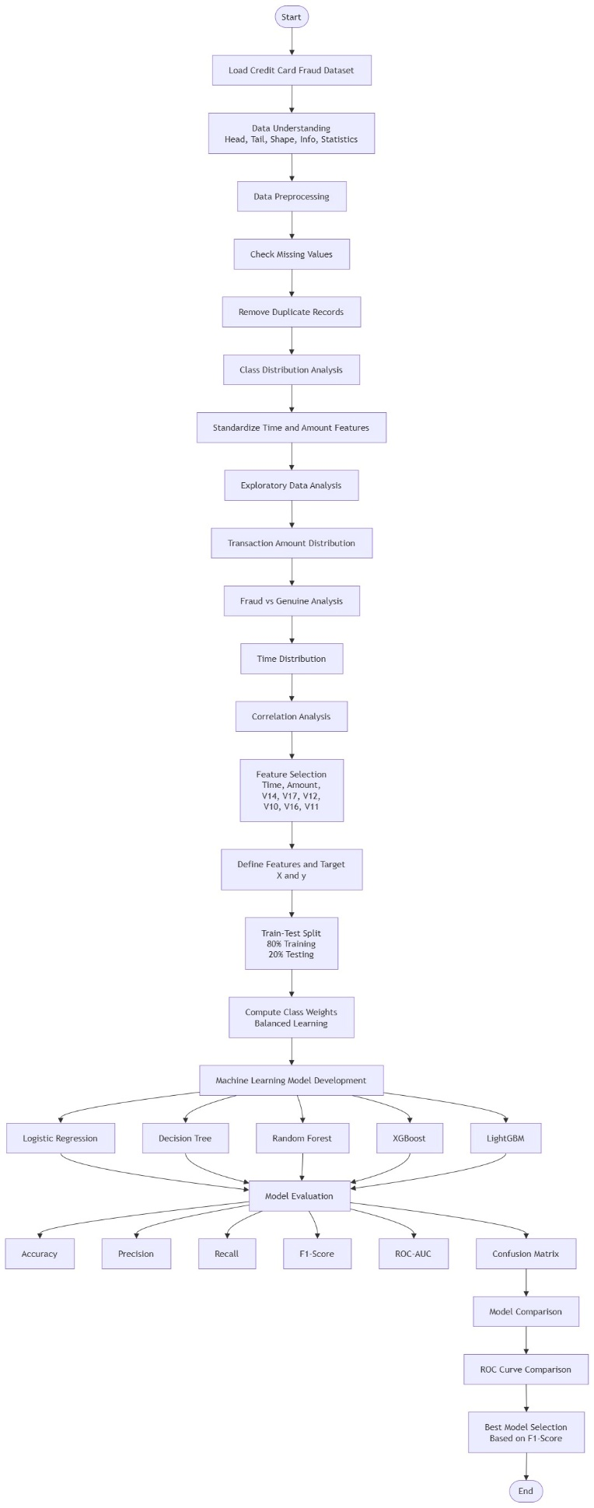
Methodology - HOW
Design: quantitative and experimental machine-learning study
Data: secondary anonymised dataset with 284,807 transactions
Tools: Python, Jupyter, Pandas, NumPy, Matplotlib and Seaborn
Current methods: cleaning, descriptive analysis and visualisation
Next methods: scaling, feature selection and stratified 80:20 split
Algorithms: LR, DT, RF, XGBoost and LightGBM
Why selected: reproducibility, fair comparison and imbalance-aware evaluation
Figure 3: Proposed Credit Card Fraud Detection Implementation Architecture
Notes:
The objectives will be met by a quantitative experimental design with a secondary anonymised dataset. Python and Jupyter are chosen to ensure a reproducible environment, Pandas and NumPy for efficient data handling, and Matplotlib and Seaborn for visual analysis of data. Completed Phase includes Quality Check and Exploration. The next step will be to scale appropriate variables, choose predictors and then split the data in a stratified 80:20 to ensure that the rare fraud class remains. Five algorithms are chosen for comparison, i.e., four interpretable, tree-based and one boosting. This is better than using a single algorithm as it allows a better comparison since it is done under the same conditions.

Slide 7
Software and Hardware Requirements
Python: main programming language [1].
Jupyter Notebook: experiment environment.
Pandas and NumPy: data handling and numerical operations.
Matplotlib and Seaborn: exploratory visualization.
Scikit-learn, XGBoost and LightGBM: planned modelling [1].
Standard computer with at least 8 GB RAM: 16 GB recommended.
Notes:
Python has been chosen as it offers a well-developed, user-friendly machine-learning environment. For the Transparent execution, documentation and reproducibility Jupyter Notebook is chosen. The loading, cleaning and analysing of the transactions are performed in pandas and NumPy, while the final visualisation is done in Matplotlib and Seaborn. In the next draft, the preprocessing, training and evaluation will be done using scikit-learn, XGBoost and LightGBM. The dataset can be easily processed on a typical modern computer, although 16 GB memory is recommended in order to experiment and compare models more smoothly.

Slide 8
Selection of Machine Learning Models
Logistic Regression: interpretable baseline.
Decision Tree: clear non-linear decision rules [3].
Random Forest: stable tree-based ensemble [5].
XGBoost: regularised gradient boosting [1].
LightGBM: efficient boosting for large datasets.
All five models will be trained in the next draft.
Notes:
Five supervised algorithms have been selected from the literature and technology review, but they have not yet been trained for this midpoint submission. Logistic Regression will provide an interpretable baseline. Decision Tree will model non-linear relationships, while Random Forest will reduce the instability of a single tree. XGBoost and LightGBM will provide advanced boosting approaches. Decision Trees may overfit if they are not controlled, while ensemble methods can improve stability and predictive capability. The same data split and evaluation measures will be used for a fair comparison.

Slide 9
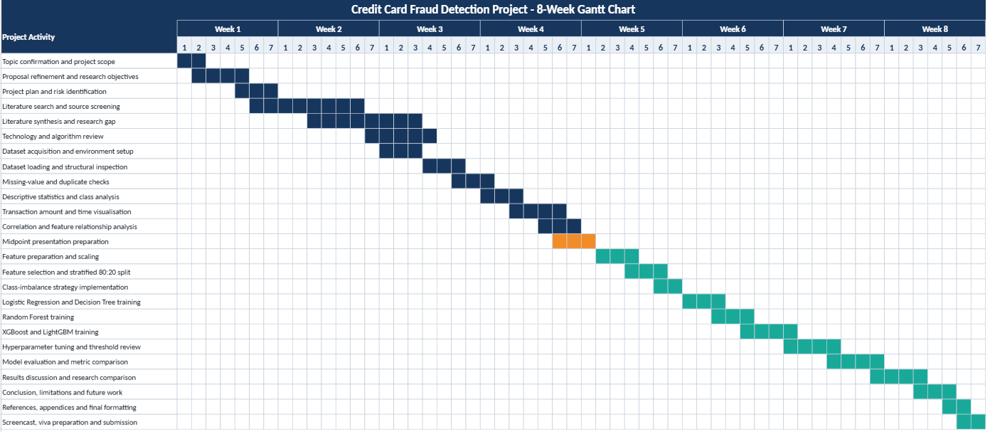
Progress and Next Steps
Completed
  Proposal development
  Literature review
  Dataset selection
  Research methodology
  Data cleaning and visualisation
Current
  Data preprocessing
  Model implementation preparation
Remaining
  Model training and evaluation
  Results analysis
  Dissertation writing and final submission
Figure 4: Gantt Chart
Notes:
The completed work includes proposal development, the literature review, dataset selection, research methodology, data-quality checks and exploratory visualisation. This is about half of the proposed project. Now it is the preprocessing and preparation of data for the model implementation. Training the model is still pending. The following works will be carried out model training, tuning, model evaluation, comparative results analysis, discussion and completion of the final report. These activities are represented in the Gantt chart below for the span of 8 weeks.

Slide 10
Literature Review
Feature selection and reproducible preprocessing have an impact on fraud-detection performance [6].
Models are prone to class imbalance bias towards true transactions when there is severe imbalance [7].
Multistage ensemble models are able to detect various fraud patterns [8].
The F1-score and the ROC-AUC are impacted by sampling and feature extraction [9].
There is no best modelling or balancing approach in all contexts [6],[9].
Research gap: The lack of a consistent comparison of Logistic Regression, Decision Tree, Random Forest, XGBoost and LightGBM with same preprocessing and evaluation metrics.
Notes:
The literature review is directly related to the problem statement and project objectives. In order to enhance the usefulness of fraud-detection models, feature selection and reproducible preprocessing can be. When the distribution of transactions is strongly skewed, the impact can be misleading when considering the accuracy of the classification system on which the system is built, as it may be overly accurate for actual transactions and may be too inaccurate for transactions that are classified as transactions. Different aspects of fraud can be modeled using ensemble methods that can combine the strengths of individual models. F1-score and ROC-AUC performance can also vary with the sampling and feature-extraction decisions.

Slide 11
Expected Contribution
Structured and reproducible fraud-detection workflow
Clear visual explanation of severe class imbalance
Consistent plan for comparing five algorithms
Use of multiple measures rather than accuracy alone
Practical basis for selecting a reliable detection model
Final contribution will be confirmed after model evaluation
Notes:
At the midpoint, the project contributes a structured and reproducible workflow for understanding an imbalanced financial dataset before modelling. The visual analysis makes the small fraud class and transaction patterns easier to interpret. The project also establishes a fair comparison plan in which five algorithms will use the same prepared data and evaluation framework. This is important because differences in preprocessing can otherwise make model comparisons unreliable. The final practical contribution cannot yet be claimed because training and evaluation remain incomplete. It will be established in the next draft after experimental evidence has been produced.

Slide 12
Conclusion
The project is progressing according to the planned workflow
Dataset understanding, cleaning and visualisation are complete
Severe class imbalance has been confirmed
Five suitable algorithms have been selected from the literature
Model training and evaluation will begin in the next draft
No best-performing model is claimed at the midpoint stage
Notes:
The results of the midpoint work show that the data is appropriate for a supervised credit card fraud detection study, but the class imbalance issue needs to be addressed carefully. Data understanding, data cleaning checks and exploratory visualisation have been completed and five suitable algorithms have been identified from literature. Until now the project has not yet been in the model training or evaluation phase, the best model is not presented at this stage. The planned preprocessing will be performed in the next draft, training of the models and their comparison will be done until the end of the study.

Slide 13
References
[1] L. Theodorakopoulos, A. Theodoropoulou, A. Tsimakis and C. Halkiopoulos, Big data-driven distributed machine learning for scalable credit card fraud detection using PySpark, XGBoost, and CatBoost, Electronics, vol. 14, no. 9, p. 1754, 2025. doi: 10.3390/electronics14091754.
[2] W. Sun, Q. Shen, Y. Gao, Q. Mao, T. Qi and S. Xu, Objective over architecture: Fraud detection under extreme imbalance in bank account opening, Computation, vol. 13, no. 12, p. 290, 2025. doi: 10.3390/computation13120290.
[3] M. Arifuzzaman, M. R. Hasan, T. J. Toma, S. B. Hassan and A. K. Paul, An advanced Decision Tree-based deep neural network in nonlinear data classification, Technologies, vol. 11, no. 1, p. 24, 2023. doi: 10.3390/technologies11010024.
[4] M. C. Hinojosa Lee, J. Braet and J. Springael, Performance metrics for multilabel emotion classification: Comparing micro, macro, and weighted F1-scores, Applied Sciences, vol. 14, no. 21, p. 9863, 2024. doi: 10.3390/app14219863.
[5] Y. Yang and H. Wang, Random Forest-based machine failure prediction: A performance comparison, Applied Sciences, vol. 15, no. 16, p. 8841, 2025. doi: 10.3390/app15168841.
[6] E. Ileberi, Y. Sun and Z. Wang, A machine learning based credit card fraud detection using the GA algorithm for feature selection, Journal of Big Data, vol. 9, art. 24, 2022. doi: 10.1186/s40537-022-00573-8.
[7] D. Breskuviene and G. Dzemyda, Enhancing credit card fraud detection: Highly imbalanced data case, Journal of Big Data, vol. 11, art. 182, 2024. doi: 10.1186/s40537-024-01059-5.
[8] M. A. Talukder, M. Khalid and M. A. Uddin, An integrated multistage ensemble machine learning model for fraudulent transaction detection, Journal of Big Data, vol. 11, art. 168, 2024. doi: 10.1186/s40537-024-00996-5.
[9] Z. Salekshahrezaee, J. L. Leevy and T. M. Khoshgoftaar, The effect of feature extraction and data sampling on credit card fraud detection, Journal of Big Data, vol. 10, art. 6, 2023. doi: 10.1186/s40537-023-00684-w.

